Slide 1
FAKE NEWS!
Determining Bias in a News Story
Tessa Blankenship
Jaci Willoughby
Notes:
Project Introduction:
Have you ever read a news story online and wondered if it came from a credible source? We live in a technology age – right? It’s so easy now to doctor photos and create fictional news that its’ really difficult to determine if a news story is actually “REAL” or if it was created to fit someone’s personal agenda. We hope to find a way to review news headlines and stories to determine the source. Knowing who the source of the story is will allow the public to judge for themselves the credibility of the story.

Slide 2
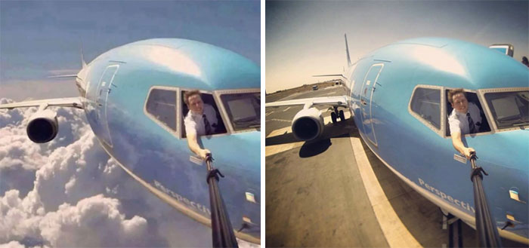
What is “Fake News” ?
fake adjective
\ ˈfāk \
: not true, real, or genuine : counterfeit, sham
news noun, plural form
\ ˈnüz , ˈnyüz \
: a report of recent events
: previously unknown information
: something having a specified influence or effect
Notes:
I’m sure by now we all have heard about “Fake News” – but for our project we need to first define what Fake News looks like. How should we define what fake news is?
We all agree that Meriam-Webster and Oxford are reliable sources in defining words- correct? Meriam-Webster has taken the stance that they will not define the term. They feel the term is a combination of the word “fake” and “news” and there is no need to define the term as a whole. BUT - the Oxford Dictionary has defined “Fake News” as a noun that means “False information that is broadcast or published as news for fraudulent or politically motivated purposes”,
For our purposes we’ll stick with the Oxford definition.

Slide 3
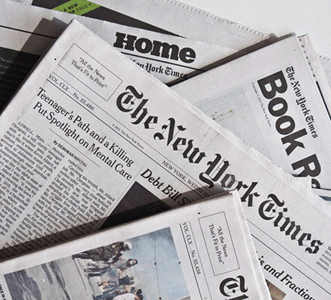
Who is the source of this information?
What would this source know? Does he or she have training in the area? A job title that would indicate knowledge?
When did the source get this knowledge? Recently? So long ago that situations might have changed?
Where did the source get this knowledge? Does he or she have a degree in this field? Training? Work experience? Was the source involved first-hand? If so, does this make his or her views more credible … or less?
Why use this source? Does he or she have the necessary expertise to be trustworthy? Does this fill in a gap in the audience’s understanding?
How transparent is the reporting? Can the audience determine the sources of information and why they are good choices?
How does this source know this information? Could I confirm the source’s information through government records, other documents, further reporting or other sources?
What is the past reliability and reputation of this source?
What is the source’s motive for providing the information? What does this source have to gain or lose? Will this information make the source look better, worse, guilty or innocent?
What defines a “Credible” source?
Notes:
For the project we also need to define what a “Credible” source is. Which is a little bit harder since we all have our won belief systems and our own standards for credibility. For some, Fox News is considered a credible source. For others it’s CNN. I think we all know that the National Enquirer reports more sensational stories compared to the New York Times. So how are we going to determine if the news stories in our data are credible? The Poynter Institute gives us these questions to ask when evaluating sources. The institute specializes in ethics and fact-checking, and is considered the world’s most influential school for journalism.

Slide 4
Why we need to know ….
41%
Gallup – Sept 2019 – Americans’ trust in mass media edges down to 41%. Only 13% trust the media “a great deal” while 28% “a fair amount”.
Government Trust
Three-quarters of Americans’ believe trust in the Federal Government is shrinking.
Personal Trust
86% of Americans feel our trust in each other needs to be improved
Media Trust
61% of Americans say the news media ignores the most important stories
Notes:
According to a New York Times article – “No one believes anything” in America today. Voters are worn out by the plethora of political news. Rather than trying to figure out the validity of the news, they would rather turn the channel to non-political topics. With the decline in trust of the media – we as Americans are finding it harder to trust in other areas of our lives. We don’t trust our Government, we have trouble trusting others with different opinions than our own, and we don’t trust the local authorities to make the right decisions during tough circumstances. By finding a system that can identify credible sources from fake sources, we could improve the trust in the media, leading to improved trust in our lives.
We've taken in to consideration all of these factotrs and come up with a hypothesis …. Tessa?

Slide 5

NEUTRAL
 | The Hill
 | The Verge
 | Independent
 | ABC News
Label Predictions
Conservative Bias
 | Breitbart News
 | Fox News
Liberal Bias
 | CNN
 | BBC News
 | The New York Times
 | The Huffington Post
 | Al Jazeera English
bias noun
/ˈbīəs/
:prejudice in favor of or against one thing, person, or group compared with another, usually in a way considered to be unfair.
Notes:
Per the website Media Bias Fact Check and a recent Washington Post article, we can start out by predicting bias in news to determine credibility. As we dive deeper into exploring the data set – these categories may change based on what we discover. It's possible that certain journalists themselves hold the bias –and not the Media entity. By establishing bias we can then leave it to the individual to determine if the news is "fake".
Which leads us to our project hypothesis and details on the data …. Tessa?

Slide 6
Hypothesis
If a news outlet can be predicted based on the content, then the outlet may show bias towards one political view or subject.
The data collected spans across different news outlets in the United States, Britain and the Middle East. The information is over the same time period, so that the content is comparable.

Slide 7
About The Data
https://www.kaggle.com/adammcmurchie/news-headlines-summary-from-select-12-sources
The data consists of the following fields:
News Source
Author
Title
Description
URL
API Requested Date
Published Date
Content
3109 articles
311 published between June and August 2019
2793 published between October 2019 and January 2020

Slide 8
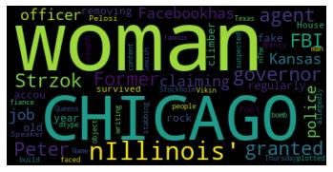
Notes:
Word clouds are a nice visual that shows the most frequently used words in the data set. The visual shows the most frequently used words in the content of the articles.

Slide 9
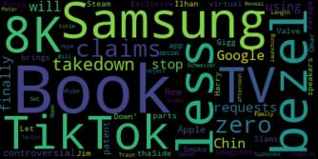
Notes:
This visual shows the most common words used in the titles.

Slide 10
References
Meriam-Webster
The Real Story of Fake News
https://www.merriam-webster.com/words-at-play/the-real-story-of-fake-news
Lexico by Oxford
https://www.lexico.com/definition/fake_news
Poynter
9 questions to help you evaluate the credibility of news sources
https://www.poynter.org/educators-students/2016/9-questions-to-help-you-evaluate-the-credibility-of-news-sources/
Gallup
Americans' Trust in Mass Media Edges Down to 41% by Megan Brenan https://news.gallup.com/poll/267047/americans-trust-mass-media-edges-down.aspx

Slide 11
References
USA Today
Trust no one? Americans lack faith in the government, the media and each other, survey finds by Alia E. Dastgir
https://www.usatoday.com/story/news/nation/2019/07/23/pew-study-american-trust-declines-government-media-and-each-other/1798963001/
Kaggle
https://www.kaggle.com/adammcmurchie/news-headlines-summary-from-select-12-sources
New York Times
No One Believes Anything’: Voters Worn Out by a Fog of Political News
https://www.nytimes.com/2019/11/18/us/polls-media-fake-news.html
The Washington Post
Ranking the media from liberal to conservative, based on their audience by Aaron Blake
https://www.washingtonpost.com/news/the-fix/wp/2014/10/21/lets-rank-the-media-from-liberal-to-conservative-based-on-their-audiences/

